Slide 1

Atlases for Organs at Risk (OARs) in Thoracic Radiation Therapy
Feng-Ming (Spring) Kong MD PhD
Leslie Quint MD
Mitchell Machtay MD
Jeffrey Bradley MD

Slide 2
Outline of Content
Atlas for lung, esophagus, and spinal cord
Atlas for brachial plexus
Atlas for proximal bronchial tree
Atlas for chest wall
Atlas for pericardium, heart and great vessels (including normal pericardial recesses)

Slide 3
RTOG 1106 Required OARs
Structure | Description | Structure definition and contouring instructions
Lung | Lungs – PreGTV (composite of CT1GTV and PETMTV) | Both lungs should be contoured using pulmonary windows. The right and left lungs can be contoured separately, but they should be considered as one structure for lung dosimetry. All inflated and collapsed, fibrotic and emphysematic lungs should be contoured, small vessels extending beyond the hilar regions should be included; however, pre GTV, hilars and trachea/main bronchus should not be included in this structure.
Heart | Heart & Pericardium | The heart will be contoured along with the pericardial sac. The superior aspect (or base) will begin at the level of the inferior aspect of the pulmonary artery passing the midline and extend inferiorly to the apex of the heart.
Esophagus | Esophagus | The esophagus should be contoured from the beginning at the level just below the cricoid to its entrance to the stomach at GE junction. The esophagus will be contoured using mediastinal window/level on CT to correspond to the mucosal, submucosa, and all muscular layers out to the fatty adventitia.
Spinalcord | Spinal Canal | The spinal cord will be contoured based on the bony limits of the spinal canal. The spinal cord should be contoured starting at the level just below cricoid (base of skull for apex tumors) and continuing on every CT slice to the bottom of L2. Neuroformanines should not be included.
Brachialplex | Brachial Plexus | This is only required for patients with tumors of upper lobes. Only the ipsilateral brachialplex is required. This will include the spinal nerves exiting the neuroforamine from top of C5 to top of T2. In contrast to prior RTOG lung studies of contouring the major trunks of the brachial plexus with inclusion of subclavian and axillary vessels, this trial requests contouring the nerves according to the CT anatomy on every other CT slice. The structure should extend at least 3 cm above the PTV.

Slide 4
RTOG 1106 Optional OARs
Structure | Description | Structure definition and contouring instructions
Pericard | Pericardium | The structure of pericardium includes pericardial fatty tissue, part of great vessels, normal recesses, pericardial effusion (if applicable) and heart chambers. Pericardium starts at one slice above the top of aortic arch, ends at the last slice of heart apex at diaphragm. Pericardium includes the heart.
Greatves Aorta SVC IVC PV PA | Great vessels Aorta Superior vena cava Inferior vena cava pulmonary vein pulmonary artery | The great vessels should be contoured separately from the heart, using mediastinal windowing to correspond to the vascular wall and all muscular layers out to the fatty adventitia (5 mm from the contrast enhanced vascular wall). The great vessel should be contoured starting at least 3 cm above the superior extent of the PTV and continuing on every CT slice to at least 3 cm below the inferior extent of the PTV. For right sided tumors, SVC will be contoured, and for left sided tumors, the aorta will be contoured. The ipsilateral PA will be delineated for tumor of either side.
Pbtree | Proximal Bronchial Tree | This structure includes the distal 2 cm of the trachea, the carina, the right and left mainstem bronchi, the right and left upper lobe bronchi, the intermedius bronchus, the right middle lobe bronchus, the lingular bronchus, and the right and left lower lobe bronchi.
CW2cm | Chest wall 2 cm outside of lung | Chest wall can be autosegmented from the ipsilateral lung with a 2-cm expansion in the lateral, anterior, and posterior directions. Anteriorly and medially, it ends at the edge of the sternum. Posteriorly and medially, it stops at the edge of the vertebral body with inclusion of the spinal nerve root exit site. CW2cm which include intercostal muscles, nerves exclude vertebrate bodies, sternum and skin. This can be accomplished through auto-expansion of the ipsilateral lung (within 3 cm range of PTV).

Slide 5
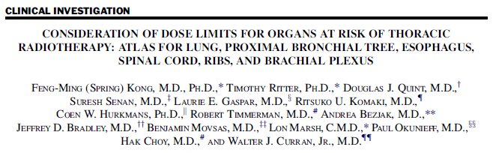
Atlas of lung, esophagus, and spinal cord
Int J Radiat Oncol Biol Phys. 2011 81(5):1442-57

Slide 6
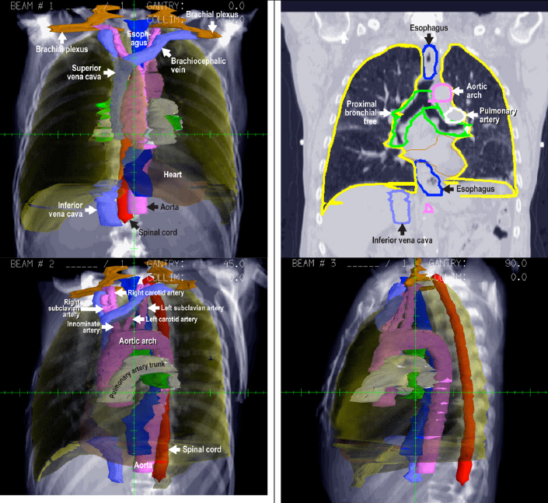

Slide 7
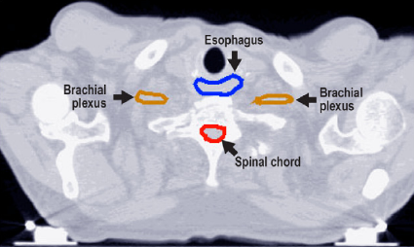
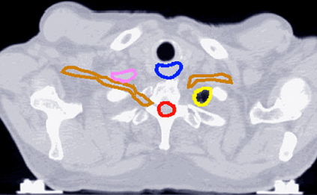
Esophagus starts at the level of cricoid
Lung is visible now of the left apex
Lung
Spinal cord should also start at this level just below the cricord or
from the base of skull C1 if scan is available, particularly when
the tumors involve neck or apex.

Slide 8
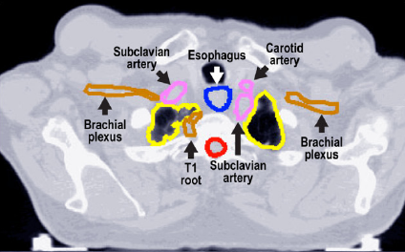
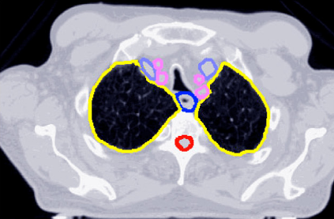
Esophagus and lung continue…
Spinal cord
The structure of spinal cord should include the entire spinal canal to decrease
contouring variations .

Slide 9
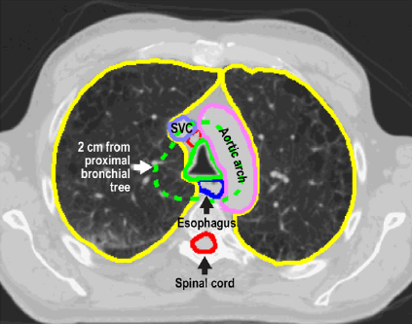
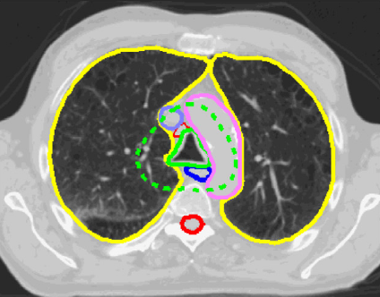
Esophagus, lung and cord continue…
Great vessels delineation is recommended, but not mandated.
Proximal Bronchial Tree
SVC=superior vena cava
Proximal bronchial tree delineation is recommended, but not mandated.

Slide 10
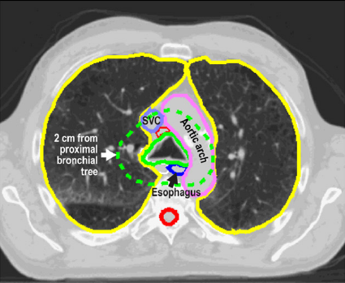
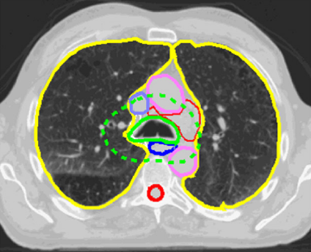
Esophagus, lung and cord continue…
great vessels start from the level of aortic arch
SVC=superior vena cava
Proximal bronchial tree starts at 2 cm above carina

Slide 11
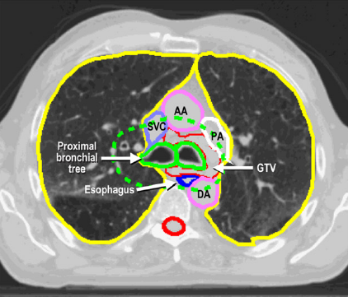
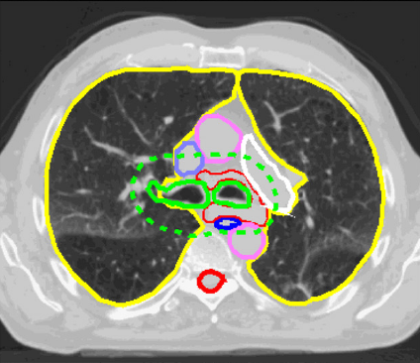
Esophagus, lung and cord continue…
and great vessels, proximal bronchial tree
AA=ascending aorta, PA=pulmonary artery, DA=descending aorta, SVC=superior vena cava

Slide 12
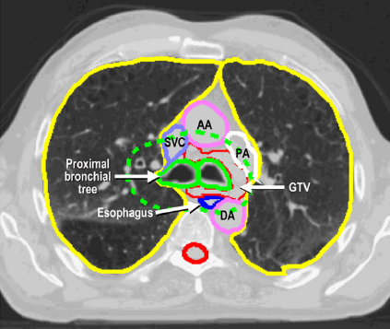
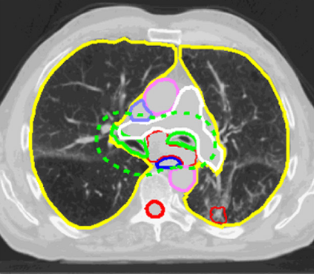
Esophagus, lung, cord, great vessels
and proximal bronchial tree
AA=ascending aorta, PA=pulmonary artery, DA=descending aorta, SVC=superior vena cava

Slide 13
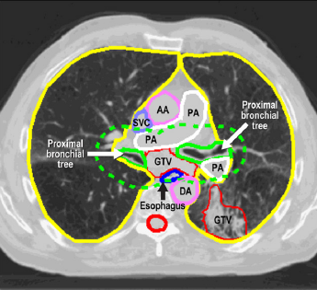
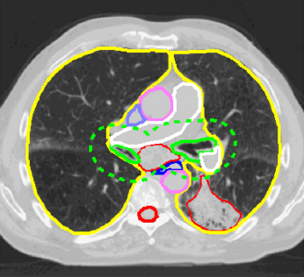
Esophagus, lung, cord, great vessels
and proximal bronchial tree
AA=ascending aorta, PA=pulmonary artery, DA=descending aorta, SVC=superior vena cava

Slide 14
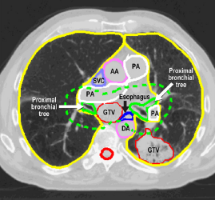
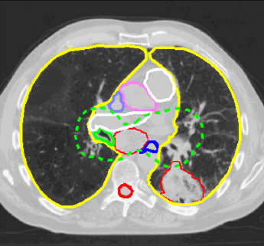
Esophagus, lung, cord, great vessels
and proximal bronchial tree continue…
AA=ascending aorta, PA=pulmonary artery, DA=descending aorta, SVC=superior vena cava

Slide 15
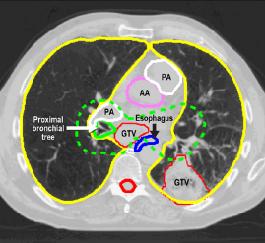
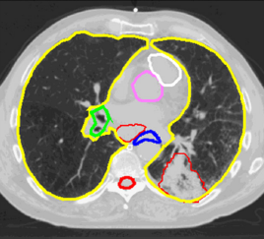
Esophagus, lung, cord, great vessels
and proximal bronchial tree
AA=ascending aorta, PA=pulmonary artery, DA=descending aorta, SVC=superior vena cava

Slide 16
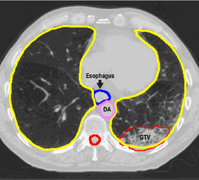
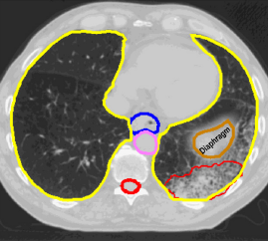
Esophagus, lung, cord continue…
DA=descending aorta

Slide 17
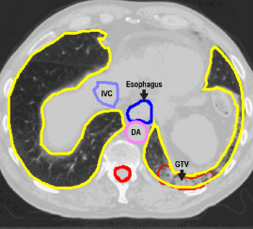
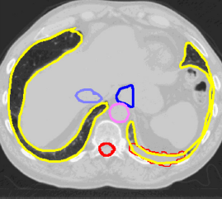
Esophagus ends at gastric-esophageal junction,
Lung and cord continue…
IVC=inferior vena cava, DA=descending aorta

Slide 18
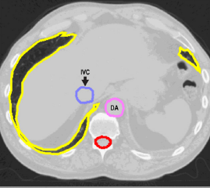
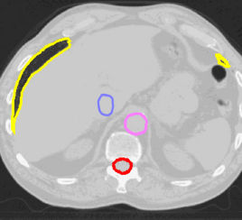
Lung ends, cord continues until the bottom of L2 Vertebral body
IVC=inferior vena cava, DA=descending aorta

Slide 19
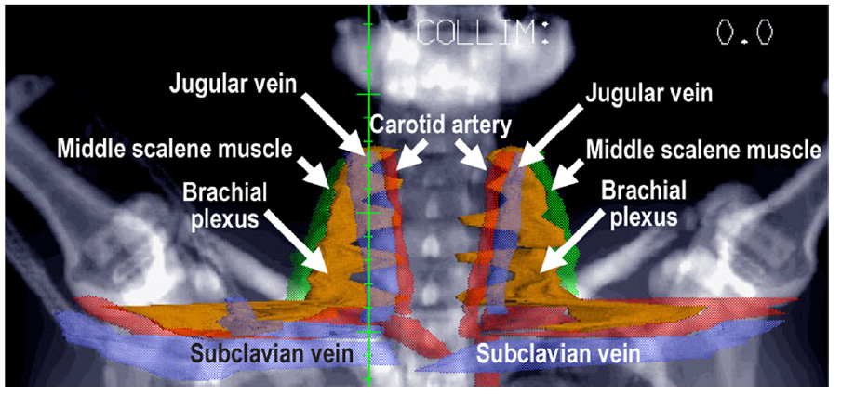
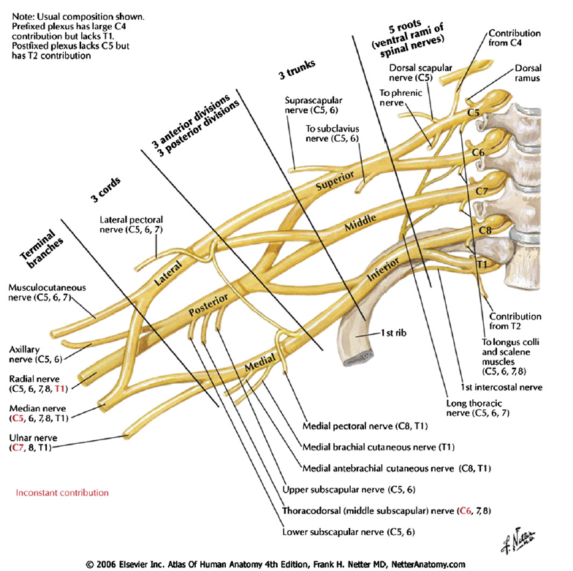
Atlas for Brachial Plexus

Slide 20
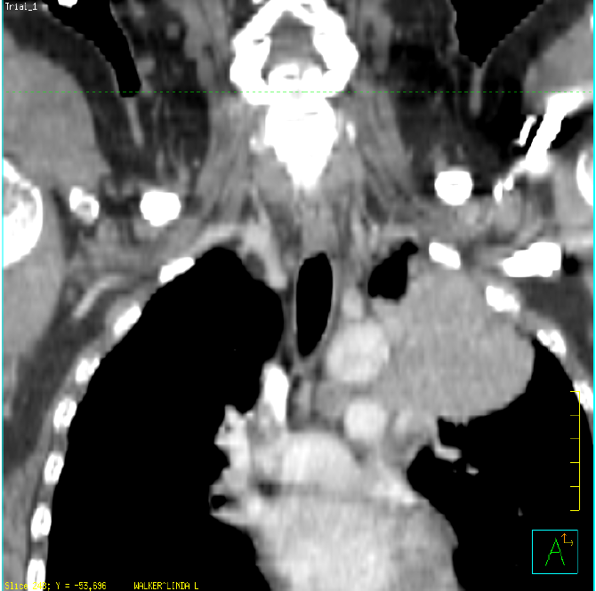
Locating the Brachial Plexus
Timmerman’s Trick-1
Vein, artery, and nerve (VAN, anterior to posterior) will go over the 1st rib and under the clavicle
Using coronal images, find the plane where vascular/nerve structures (tubes and wires) pass between the 1st rib and clavicle
Roughly contour these neuro-vascular tissues in this coronal plane (as shown in yellow)
You will use these rough contours in the next step
clavicle
1st rib

Slide 21
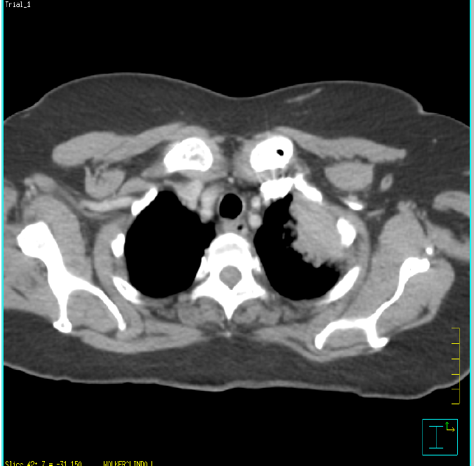
Locating the Brachial Plexus
Timmerman’s Trick-1
Project coronal contours onto axial images (yellow points shown on axial image)
In the region between the projected points, identify the VAN on either side. Contour the “N” as the root(s) of the brachial plexus
Note: Finding the brachial plexus on the uninvolved side will help in finding it on the involved side
Note: IV contrast greatly facilitates this task (see contrast in artery)
V
N
A

Slide 22
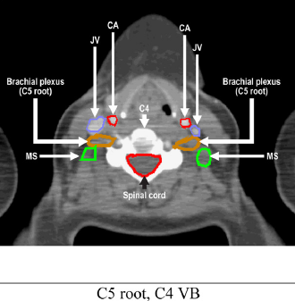
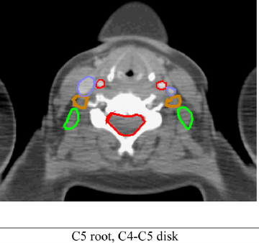
Brachial plexus starts between C4 C5

Slide 23
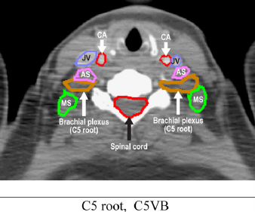
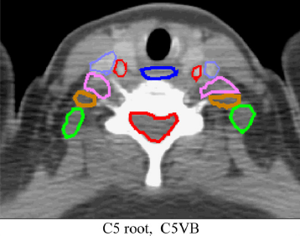

Slide 24
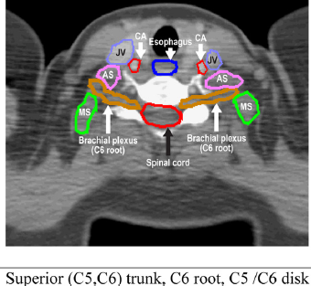
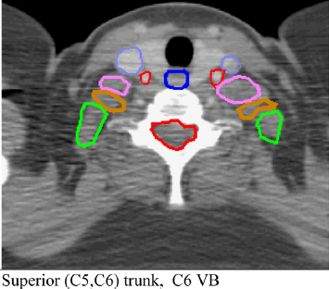

Slide 25
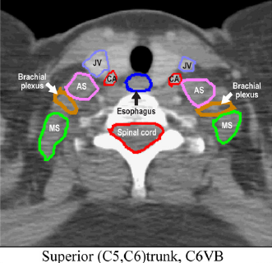
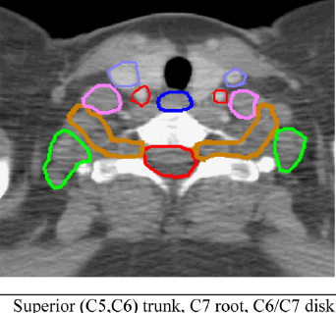

Slide 26
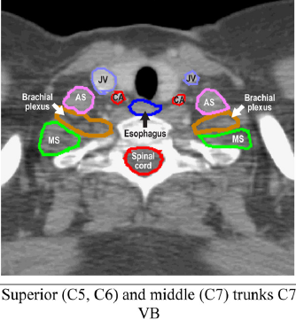
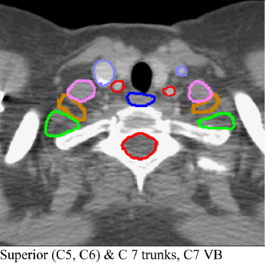

Slide 27
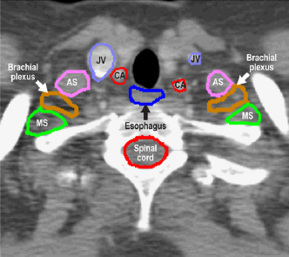
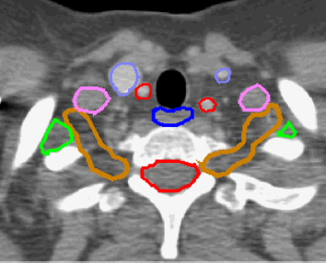

Slide 28
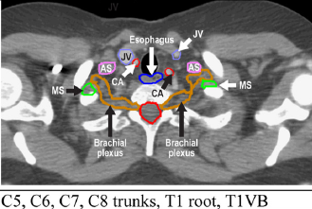
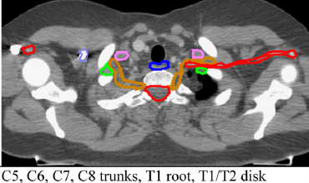

Slide 29
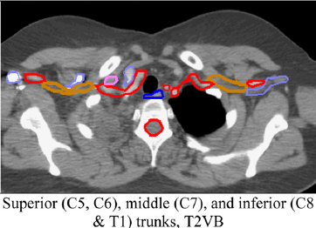
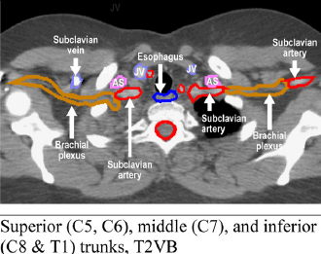

Slide 30
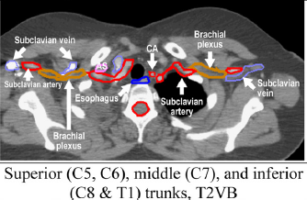
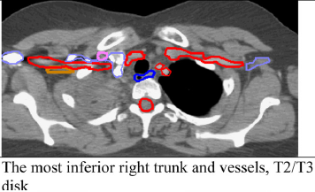
Vein
Artery
Nerve

Slide 31
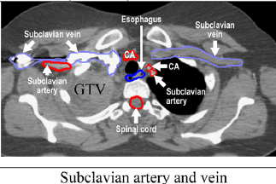
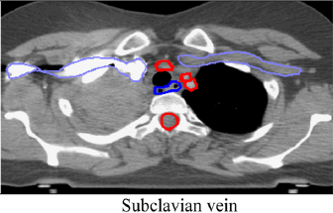
Brachial plexus not visible any more

Slide 32

Proximal Bronchial Tree (PBT)
PBT should include the distal 2 cm of the trachea, the carina, the right and left mainstem bronchi, the right and left upper lobe bronchi, the intermedius bronchus, the right middle lobe bronchus, the lingular bronchus, and the right and left lower lobe bronchi (a, b, c, d, e, f, g in the figure)
PBT can be contoured by autosegmenting the airspace of the central airway with 3 mm expansion (2 mm for lobar bronchus, 3 mm for main bronchus, 4 mm for trachea)

Slide 33
Proximal Bronchial Tree
The proximal bronchial tree can be contoured using mediastinal windows on the CT scan to correspond to the mucosal, submucosa, and cartilage rings and airway channels associated with these structures. It can be contoured as one structure, including the most inferior 2 cm of distal trachea and the proximal airways of both sides. Contouring the lobar bronchi should end immediately at the level of a segmental bifurcation.
Recommendation based on Timmerman et al for RTOG 0236 and RTOG 0618,
Bezjak et al for RTOG 0813

Slide 34

PBT starts at 2 cm above carina

Slide 35

Proximal Bronchus Tree continues…

Slide 36

Proximal Bronchus Tree continues…

Slide 37

Proximal Bronchus Tree Continues…

Slide 38

Proximal Bronchus Tree continues…

Slide 39


Slide 40


Slide 41


Slide 42


Slide 43


Slide 44


Slide 45


Slide 46


Slide 47


Slide 48


Slide 49


Slide 50

Proximal Bronchus Tree Ends
at the level of lobar bronchus bifurcating
into segmental bronchus

Slide 51
Chest Wall Contours
Chest wall can be autosegmented from the ipsilateral lung with a 2-cm expansion in the lateral, anterior, and posterior directions. Anteriorly and medially, it ends at the edge of the sternum. Posteriorly and medially, it stops at the edge of the vertebral body with inclusion of the spinal nerve root exit site.
This recommendation was:
based on Kong et al, Int J Radiat Oncol Biol Phys. 2010 Oct 7. [Epub ahead of print]
Supported by “CW2cm consistently enabled better prediction of CW toxicity than CW3cm” in Mutter et al, Int J Radiat Oncol Biol Phys. 2011 Aug 23. [Epub ahead of print]

Slide 52


Chest Wall (CW)
CW refers to CW2cm which include intercostal muscles, nerves
exclude vertebral bodies, sternum and skin. This can be accomplished through auto-expansion of the ipsilateral lung (within 3 cm range of PTV).
Chest wall
CW contouring starts at 3 cm above the PTV

Slide 53


Chest Wall
CW refers to CW2cm which include intercostal muscles, nerves
exclude vertebral bodies, sternum and skin.
PTV
The superior end of PTV

Slide 54


Chest Wall
CW refers to CW2cm which include intercostal muscles, nerves
exclude vertebral bodies, sternum and skin.
PTV
GTV
The superior end of GTV

Slide 55


Chest Wall
CW refers to CW2cm which include intercostal muscles, nerves
exclude vertebral bodies, sternum and skin.
Chest wall contours around GTV.

Slide 56


Chest Wall
CW refers to CW2cm which include intercostal muscles, nerves
exclude vertebral bodies, sternum and skin.
The inferior end of PTV
3 cm below PTV
CW ends at 3cm from the inferior edge of PTV.

Slide 57
Pericardium/Heart, Great Vessels, Heart Chambers, and Normal Pericardial Recesses
Feng-Ming (Spring) Kong (RTOG), Leslie Quint (ACRIN), Jeffrey Bradley (RTOG), Suresh Senan (EORTC), Ritsuko Komaki (RTOG), Laurie Gaspar (SWOG), Luying Xu (UM), Chengbo Han (UM), Jun Liu (UM), Weili Wang (UM), Robin Marsh (UM), Randall Ten Haken (UM), Charles Thomas (SWOG), Jeffrey Bogart (CALGB), Mitchell Machtay (RTOG)

Slide 58
Pericardium, normal recesses and heart chambers
The structure of pericardium includes pericardial fatty tissue,
part of great vessels, normal recesses, pericardial effusion
(if applicable) and heart chambers.

Slide 59

Anatomy of Pericardium
Pericardial sac and normal recesses

Slide 60


Pericardial Normal Recesses
Vesely et al, 1986
Groell et al, Radiology, 1999

Slide 61

SVC
AA
AA=ascending aorta, SVC=superior vena cava

Slide 62

SVC
AA
Posterior superior anterior recesses (pSAR)
AA=ascending aorta, V=superior vena cava

Slide 63

AA
SVC
DA
AA=ascending aorta, DA=descending aorta, SVC=superior vena cava

Slide 64

Anterior superior aorta recess (aSAR)
Pericardium
AA
V
DA
Posterior superior
aorta recess (pSAR)
AA=ascending aorta, DA=descending aorta, SVC=superior vena cava

Slide 65

Anterior superior aorta recess (aSAR)
Pericardium
AA
AA
SVC
PA
DA
Posterior superior
aorta recess (pSAR)
AA=ascending aorta, DA=descending aorta, SVC=superior vena cava,
PA= pulmonary artery

Slide 66

Pericardium
Pericardium
Pericardium
AA
MPA
DA
AA=ascending aorta, DA=descending aorta, MPA=main pulmonary artery

Slide 67

Right superior aortic recess (rSAR)
Pericardium
Left pulmonic recess (LPR)
AA
SVC
PA
LA
DA
Pericardium
AA=ascending aorta, DA=descending aorta, V=superior vena cava,
PA=main pulmonary artery, PA=right pulmonary artery, LA=left atrium

Slide 68

Pericardium
MPA
Right pulmonic recess (RPR)
RA
Pericardium
AA
SVC
LA
E
DA
Posterior Pericardial recess (PPR)
Pericardium
RA=right atrium, AA=aortic arch, LV=left ventricle, LA=Left atrium, MPA=main pulmonary artery, DA=descending aorta, E=esophagus

Slide 69

Pericardium
Pericardium
Pericardium
RV
RA
AA
LV
LA
E
DA
Oblique sinus (OS)
RA=right atrium, RV=right ventricle, LV=left ventricle, LA=Left atrium,
AA=aortic arch, DA=descending aorta, E=esophagus

Slide 70

Pericardium
Pericardium
RV
RA
AA
LV
LA
RA=right atrium, RV=right ventricle, LV=left ventricle, LA=Left atrium, AA=Ascending Aorta

Slide 71

Pericardium effusion (PEFF)
Pericardium
Pericardium
RV
RA
LV
LA
DA
RA=right atrium, RV=right ventricle, LV=left ventricle, LA=Left atrium, AA=aortic arch

Slide 72

Pericardial effusion (PEFF)
Pericardium
Pericardium
RV
RA
LV
LA
E
Pericardium
DA
RA=right atrium, RV=right ventricle, LV=left ventricle, LA=Left atrium

Slide 73

Pericardium
LIVER
LV
Pericardium
Pericardial effusion (PEFF)

Slide 74
Atlas for Heart and Pericardium
Pericardium: based on anatomy
Heart: based on consensus contours of most RTOG centers/previous trials, actually including part of pericardium

Slide 75


Pericardium starts
Brachiocephalic vein
Left carotid artery
Pericardium
Innominate artery
Pericardium
A
Subclavian
artery
Pericardium starts at 1-2 slices (5-6 mm) above the superior end of the aortic arch

Slide 76


Pericardium continues…
SVC
Pericardium
SVC
Pericardium
Aortic Arch
Aortic Arch
SVC=superior vena cava

Slide 77


Pericardium continues…
SVC
Pericardium
SVC
Pericardium
Aortic Arch
Aortic Arch
SVC=superior vena cava

Slide 78


Pericardium continues…
SVC
Pericardium
SVC
Pericardium
AA
Aortic Arch
DA
SVC=superior vena cava

Slide 79


Pericardium continues…
SVC
Pericardium
SVC
Pericardium
AA
AA
DA
DA
SVC=superior vena cava
AA=Ascending aorta
DA=Descending aorta

Slide 80


Pericardium continues…
SVC
Pericardium
SVC
Pericardium
AA
AA
PA
PA
DA
DA
SVC=superior vena cava
PA=Pulmonary artery
AA=Ascending aorta
DA=Descending aorta

Slide 81


SVC
Pericardium
SVC
Pericardium
AA
AA
PA
PA
DA
DA
SVC=Superior vena cava
PA=Pulmonary artery
AA=Ascending aorta
DA=Descending aorta

Slide 82


Pericardium Continues…
Pericardium
Pericardium
AA
AA
SVC
SVC
PA
PA
DA
DA
SVC=Superior vena cava
PA=Pulmonary artery
AA=Ascending aorta
DA=Descending aorta

Slide 83


Pericardium Continues…
Pericardium
Pericardium
AA
AA
SVC
PA
SVC
PA
PA
PA
DA
DA
CT-GTV
SVC=superior vena cava
PA=Pulmonary artery
AA=Ascending aorta
DA=Descending aorta

Slide 84


Pericardium Continues…
Pericardium
Pericardium
AA
AA
SVC
PA
SVC
PA
PA
PA
DA
DA
CT-GTV
CT-GTV
SVC=Superior vena cava
PA=Pulmonary artery
AA=Ascending aorta
DA=Descending aorta

Slide 85


Pericardium Continues…
Pericardium
Pericardium
AA
AA
PA
SVC
PA
SVC0
PV
PA
PV
DA
CT-GTV
DA
CT-GTV
SVC=Superior vena cava
PA=Pulmonary artery
AA=Ascending aorta
DA=Descending aorta

Slide 86


Pericardium continues… Heart contour starts at this level, 1 slice below pulmonary artery trunk passing the midline
Heart
Pericardium
Heart
Pericardium
AA
PA
AA
PA
PV
SVC
PV
SVC
PA
PV
PA
PV
CT-GTV
CT-GTV
DA
DA
Heart and pericardium are to be overlapped.

Slide 87


Heart and pericardium continue…
Heart
Pericardium
Heart
Pericardium
AA
PA
PA
AA
PV
SVC
SVC
LV
PA
LA
PV
LA
PA
PA
PV
CT-GTV
DA
CT-GTV
DA
AA=Ascending Aorta, PA=pulmonary artery, RA=right atrium,
RV=right ventricle, LV=left ventricle, LA=Left atrium,
PV=pulmonary vein, DA=descending aorta, SVC=superior vena cava

Slide 88


Pericardium and Heart continue…
Heart
Pericardium
Heart
Pericardium
PA
PA
RA
AA
RA
AA
LV
LV
LA
LA
PA
PV
CT-GTV
DA
CT-GTV
DA
RA=right atrium, RV=right ventricle
LV=left ventricle, LA=Left atrium
DA=descending aorta

Slide 89


Pericardium and Heart continue…
Heart
Pericardium
Heart
Pericardium
PA
RV
RA
AA
RA
LV
LV
LA
PA
LA
PV
DA
PV
CT-GTV
DA
CT-GTV
AA=Ascending Aorta, PA=pulmonary artery, RA=right atrium, RV=right ventricle
LV=left ventricle, LA=Left atrium, PV=pulmonary vein, DA=descending aorta

Slide 90


Heart and pericardium continue…
Heart
Pericardium
Heart
Pericardium
RV
RV
RA
LV
RA
LV
LA
LA
PV
PV
CT-GTV
DA
CT-GTV
DA
RA=right atrium, RV=right ventricle
LV=left ventricle, LA=Left atrium
DA=descending aorta

Slide 91


Heart and pericardium continue…
Heart
Pericardium
Heart
Pericardium
RV
RV
RA
LV
RA
LV
LA
LA
DA
PV
DA
CT-GTV
CT-GTV
RA=right atrium, RV=right ventricle
LV=left ventricle, LA=Left atrium
DA=descending aorta

Slide 92


Heart and pericardium continue…
Heart
Pericardium
Heart
Pericardium
RV
RV
RA
LV
RA
LV
LA
LA
DA
DA
CT-GTV
CT-GTV
RA=right atrium, RV=right ventricle
LV=left ventricle, LA=Left atrium
DA=descending aorta

Slide 93


Heart and pericardium continue…
Heart
Pericardium
Heart
Pericardium
RV
RV
RA
LV
RA
LV
LA
DA
DA
CT-GTV
CT-GTV
RA=right atrium, RV=right ventricle
LV=left ventricle, LA=left atrium
DA=descending aorta

Slide 94


Heart and pericardium continue…
Heart
Pericardium
Heart
Pericardium
RV
RV
RA
LV
RA
LV
IVC
DA
DA
CT-GTV
CT-GTV
IVC=inferior vena cava
RA=right atrium, RV=right ventricle
LV=left ventricle
DA=descending aorta

Slide 95


Heart and pericardium continue…
Heart
Pericardium
Heart
Pericardium
RV
RV
RA
RA
LV
LV
IVC
IVC
DA
DA
CT-GTV
CT-GTV
IVC=inferior vena cava
RA=right atrium, RV=right ventricle
LV=left ventricle
DA=descending aorta

Slide 96


Heart and pericardium continue…
Heart
Pericardium
Heart
Pericardium
RV
RV
RA
LV
RA
LV
IVC
IVC
DA
DA
CT-GTV
CT-GTV
IVC=inferior vena cava
RA=right atrium, RV=right ventricle
LV=left ventricle
DA=descending aorta

Slide 97


Heart and pericardium continue…
Heart
Pericardium
Heart
Pericardium
RA
LV
LV
IVC
IVC
DA
DA
IVC=inferior vena cava
RA=right ventricle
LV=left ventricle
DA=descending aorta

Slide 98


Heart and pericardium continue…
Heart
Pericardium
Heart
Pericardium
LV
LV
IVC
IVC
DA
DA
IVC=inferior vena cava
LV=left ventricle
DA=descending aorta

Slide 99


Heart and pericardium end at diaphragm
Heart
Pericardium
LV
IVC
IVC
DA
DA
IVC=inferior vena cava
LV=left ventricle
DA=descending aorta

Slide 100
Chest Wall Contours
Chest wall can be autosegmented from the ipsilateral lung with a 2-cm expansion in the lateral, anterior, and posterior directions. Anteriorly and medially, it ends at the edge of the sternum. Posteriorly and medially, it stops at the edge of the vertebral body with inclusion of the spinal nerve root exit site.
This recommendation was:
based on Kong et al, Int J Radiat Oncol Biol Phys. 2010 Oct 7. [Epub ahead of print]
Supported by “CW2cm consistently enabled better prediction of CW toxicity than CW3cm” in Mutter et al, Int J Radiat Oncol Biol Phys. 2011 Aug 23. [Epub ahead of print]

Slide 101
Chest Wall (CW)
CW refers to CW2cm which include intercostal muscles, nerves
exclude vertebrate bodies, sternum and skin. This can be accomplished through auto-expansion of the ipsilateral lung (within 3 cm range of PTV).
Chest wall
CW contouring starts at 3 cm above the PTV

Slide 102
Chest Wall
CW refers to CW2cm which include intercostal muscles, nerves
exclude vertebral bodies, sternum and skin.
PTV
The superior end of PTV

Slide 103
Chest Wall
CW refers to CW2cm which include intercostal muscles, nerves
exclude vertebral bodies, sternum and skin.
PTV
GTV
The superior end of GTV

Slide 104
Chest Wall
CW refers to CW2cm which include intercostal muscles, nerves
exclude vertebral bodies, sternum and skin.
Chest wall contours around GTV.

Slide 105
Chest Wall
CW refers to CW2cm which include intercostal muscles, nerves
exclude vertebral bodies, sternum and skin.
The inferior end of PTV
3 cm below PTV
CW ends at 3cm from the inferior edge of PTV.

Slide 106
Acknowledgement
We are grateful for pictures prepared by Leslie Quint MD, Steven Kronenberg, Daniel Tatro, Dr. Chenbo Han, Dr. Weili Wang and Paul Stanton.

